Slide 1
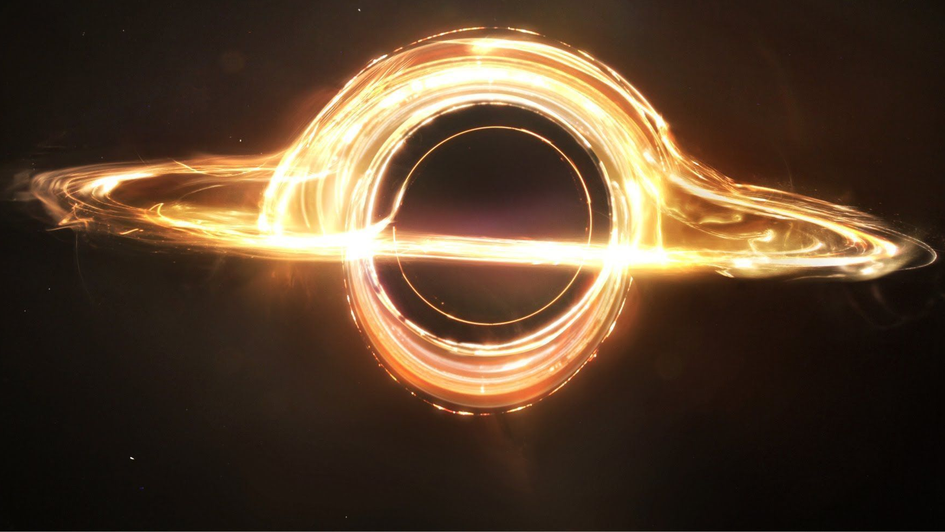
BLACK HOLE

Slide 2
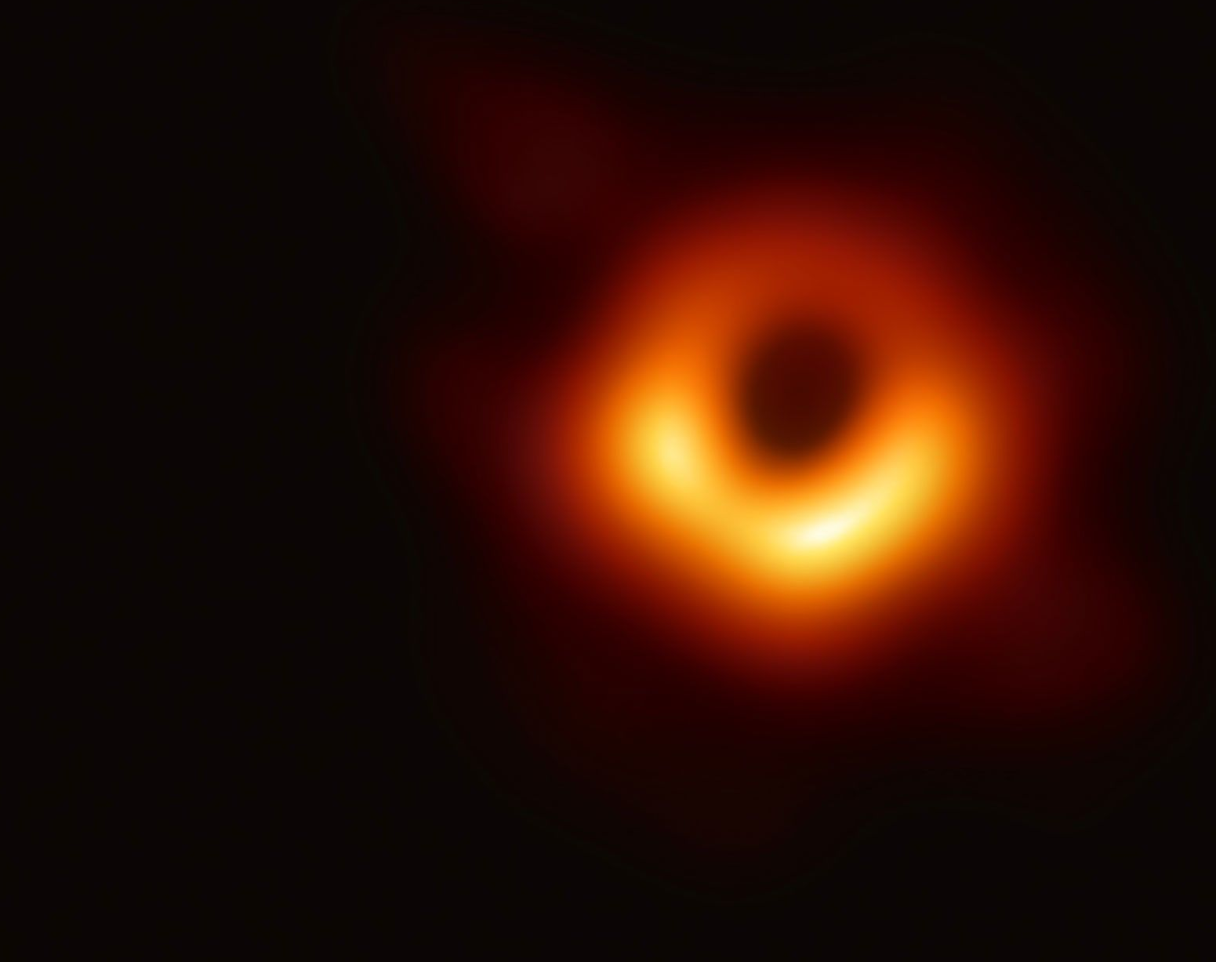
WHAT IS BLACK HOLE?
A black hole is a place in space where gravity pulls so much that even light can not get out.

Slide 3
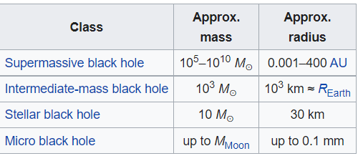
Black hole classifications:

Slide 4
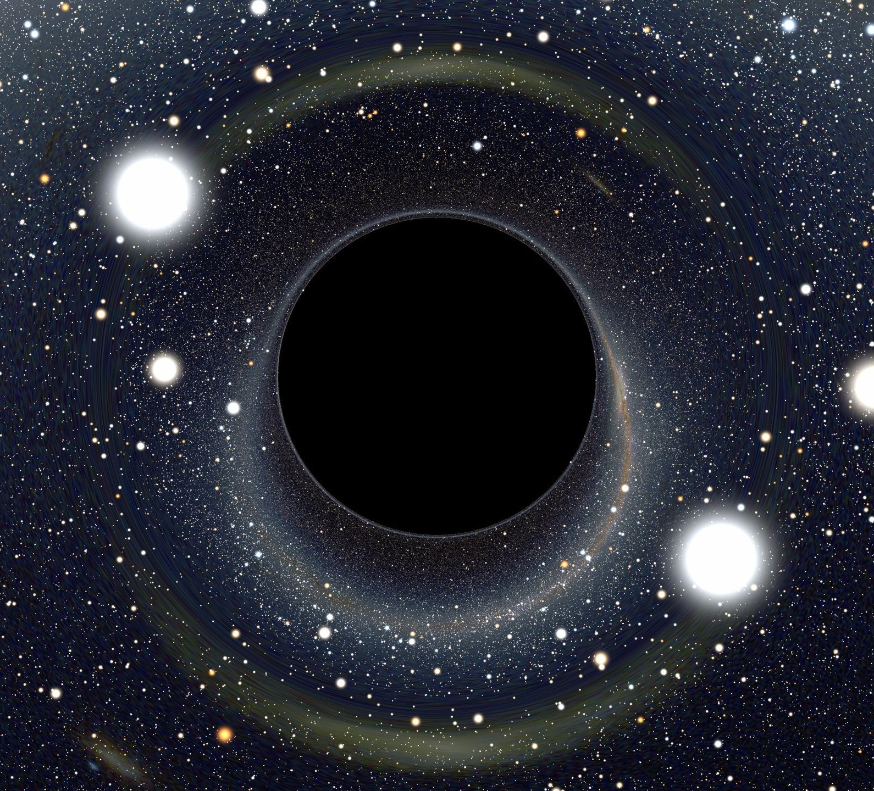
Properties and structure
Physical properties
Event horizon
Singularity
Photon sphere
Innermost stable circular orbit (ISCO)

Slide 5
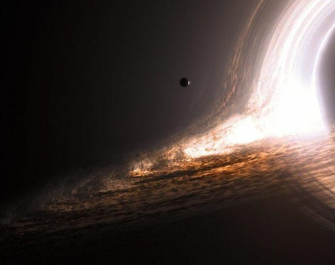
Event Horizon:
A notional boundary around a black hole beyond which no light or other radiation can escape.

Slide 6
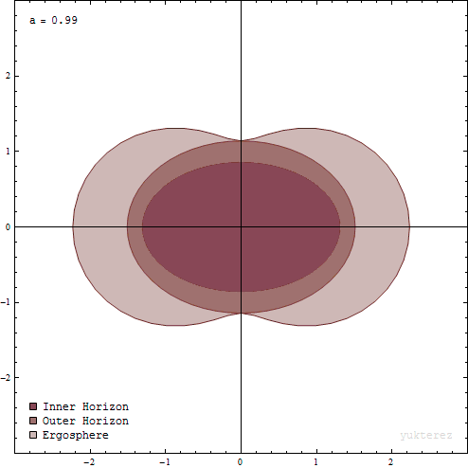
Classifications of Event horizon
Inner Horizon
Outer Horizon
Ergosphere

Slide 7
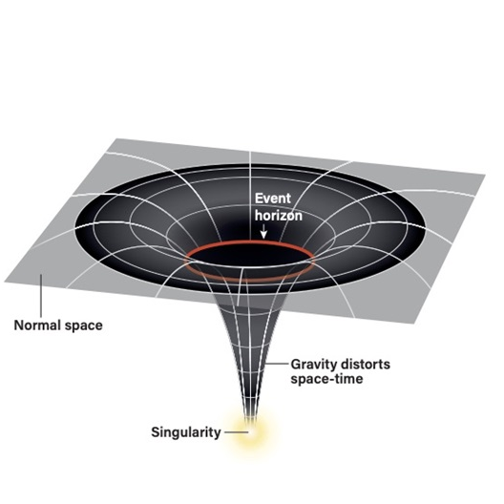
Singularity:
A singularity refers to a place in the universe where our laws of physics simply break down. These are called singularities.

Slide 8
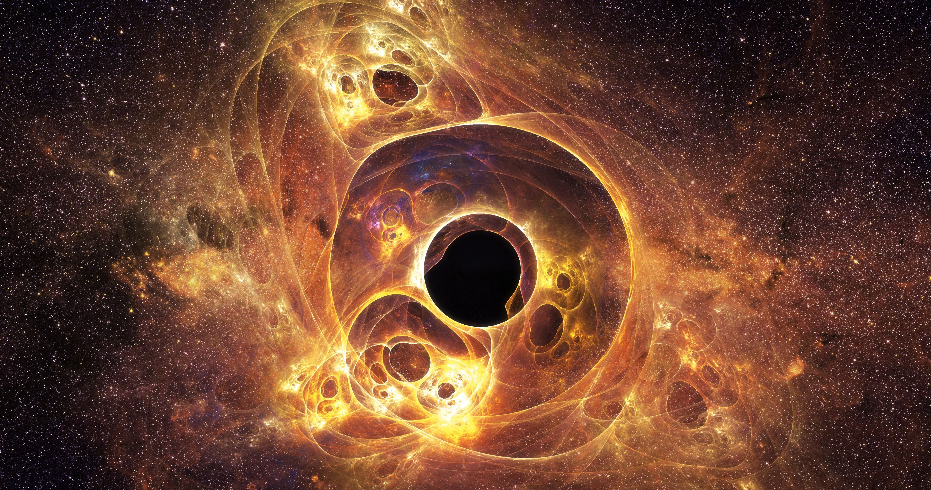
Formation and evolution
Gravitational collapse
Primordial black holes and the Big Bang
High-energy collisions
Growth
Evaporation

Slide 9
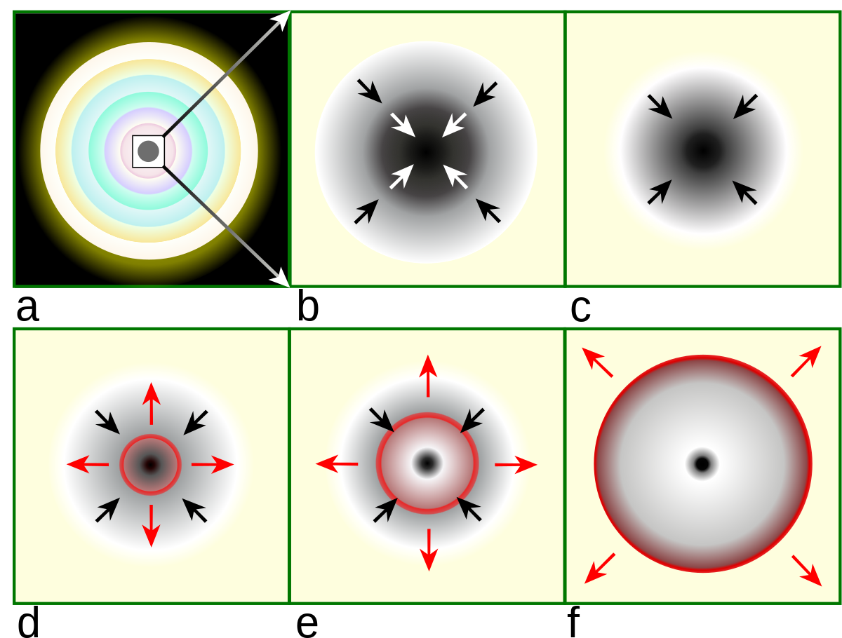
Gravitational collapse
Gravitational collapse occurs when an object's internal pressure is insufficient to resist the object's own gravity.

Slide 10
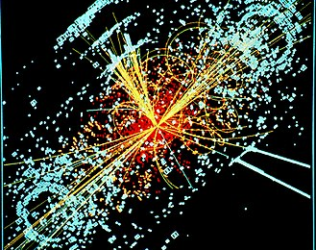
High-energy collisions
High energy collisions is a important issue for black hole.

Slide 11
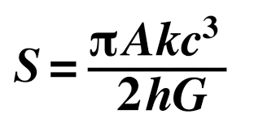
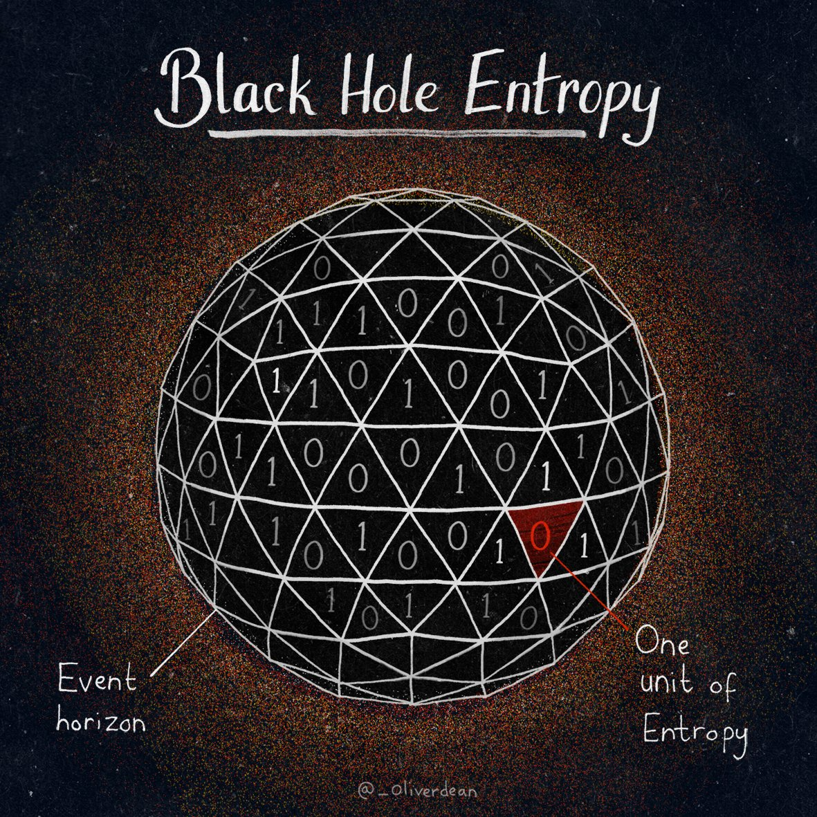
Entropy and thermodynamics

Slide 12
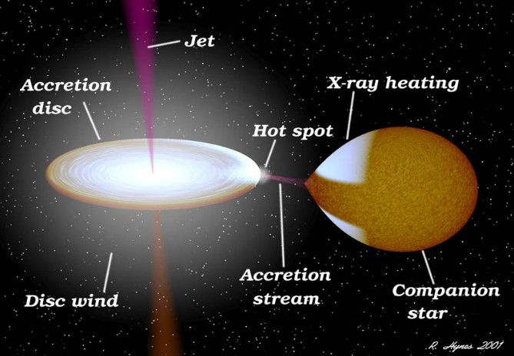
X-ray binaries
X-ray binaries are binary star systems that emit a majority of their radiation in the X-ray part of the spectrum.

Slide 13
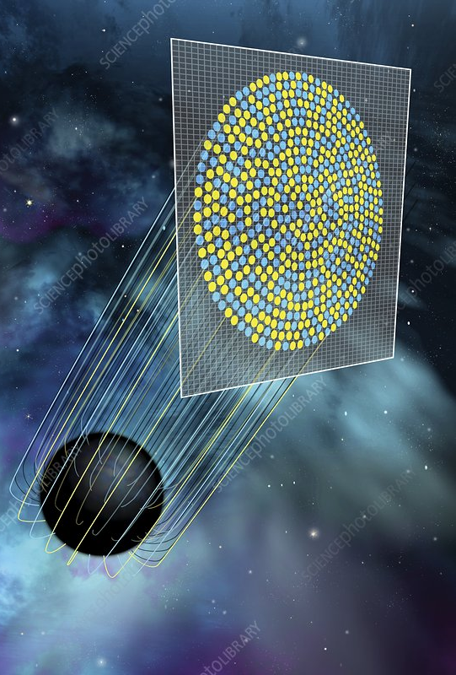
Information loss paradox
The "black hole information paradox" refers to the fact that information cannot be destroyed in the universe, and yet when a black hole eventually evaporates, whatever information was gobbled up by this cosmic vacuum cleaner should have long since vanished.

Slide 14
Thank you

